Slide 1
Creating Sensory Friendly Tents, Lounges and Spaces

Slide 2
Why do Sensory-Inclusive Spaces Matter?
Neurodiversity: variations of cognitive functioning in individuals
Invisible disability
Includes populations:
Autism: 1 in 36 prevalence in MN
ADHD
Dyspraxia
More
Affects all racial, ethnic and socio-economic groups
Provides an inclusive resource
Provides culture of acceptance
Provides a sense of belonging
Crisis reduction space
Events and organizations with inclusive spaces have greater engagement
Attendees are able to stay at events and organizations longer
Everyone benefits from these spaces

Slide 3
Successful Sensory-Friendly Spaces Include
Providing a physical space
Providing kits and tools
Hosting special times or inclusive events
Staff development trainings
Social narratives
Changing/adapting the physical space if needed

Slide 4
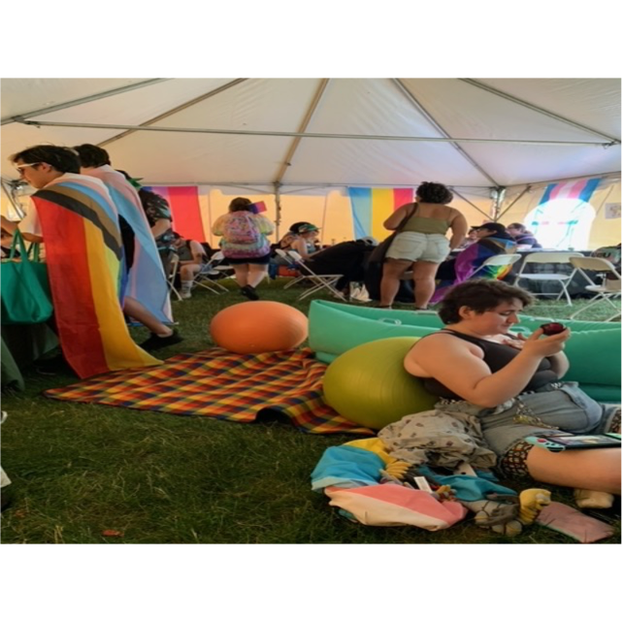
What is a Sensory Tent/Space/Lounge?
It is an accessibility support. Guests should not be charged to use it.
It is a welcoming area that is judgement free.
It’s for guests that are feeling overwhelmed or need help increasing/decreasing sensory input.
It’s a space for those guests to stim (self-sooth) comfortably, decompress, and take a break for however long they need.
These spaces are more than just areas with toys and fidgets – they are regulation zones.
It is a space that can be used by anyone who needs it, regardless of diagnosis, age, or visible disability

Slide 5
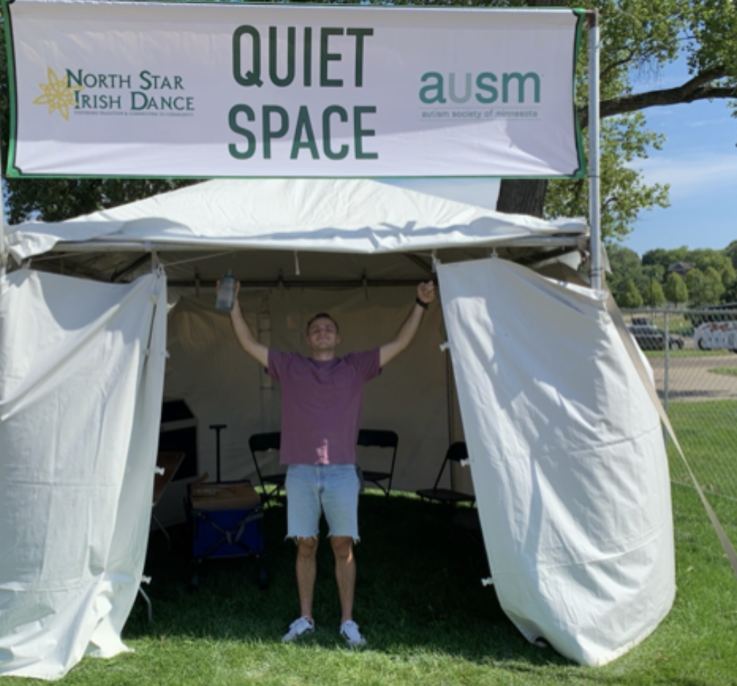
Sensory Tent Set Up Considerations
Tent or Outside Space
Open or closed?
A/C?
Provide Sensory Accommodations
Noise canceling headphones/sunglasses
Bottles of water
Sensory fidgets and materials
AuSM provides kits that fit your budgets
Multiple seating options
A blanket with pillows on the floor
A chair, a rocking chair, an exercise ball
Proximity to noise

Slide 6
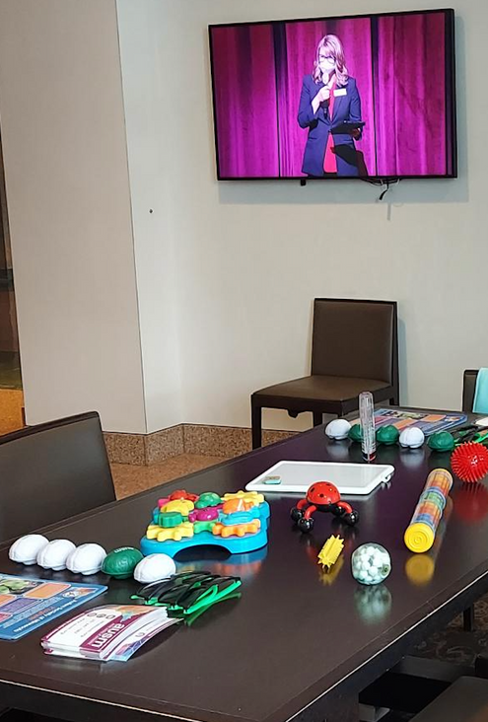
Sensory Lounge or Quiet Space Considerations
Does our event/organization have a space that we can convert into a sensory space?
No
Are there quieter areas at our organization that we can recommend to guests?
Yes
How do we adapt this space into a calming environment for overwhelmed guests?
How can we provide tools for our guests to help regulate?
Provide a checkout bag with fidgets, headphones and perhaps an event/organization map/activity/social narrative
Provide sensory items and social narratives in the sensory space
Have clear signs and information so guests can find the sensory space

Slide 7
How to set up a space
Have an area with chairs, couches, exercise balls, or rocking chairs with a small table or two.
Set up a comfortable area where guests can sit on the ground, perhaps providing a blanket, pillows, yoga mat, or foam squares.
Lay out the fidgets on a primary table with a cleaning bin (for staff to disinfect). Fidgets and tools should be based on the different senses.
Place resources on the table (yoga or exercise instructions, social narrative of the event, AuSM handouts, coloring sheets, etc.).
Everyone will have a specific routine of setting up the space – that’s ok. There’s no wrong way.

Slide 8
Staffing
Staff Development
Staff are adequately trained with proactive strategies if an individual is overwhelmed, distressed or having a meltdown.
Staff can adequately provide appropriate evidence-based resources to guests.
Staff have a deeper understanding of autism, neurodivergent disorders and universal design.
Staff are confident and prepared.
Is the Organization Able to Staff Events
Yes
Number of staff depends on your event and sensory space size.
No
How can we create inclusive spaces without having staffing?

Slide 9
Welcome Everyone
When hosting the sensory tent/lounge/space, welcome all who enter. Let them know that staff are a resource if they need help.
Remember some people may want to sit quietly and not talk. That is ok. It’s good to let the quest know that if they want to talk, that staff are here to listen and discuss.

Slide 10
Provide resources for The 8 Senses
Tactile (touch)
e.g. Squish a ball
Visual (sight)
e.g. Watch a video on a phone, draw something, wear sunglasses
Auditory (hearing)
e.g. Wear noise canceling headphones, listen to music or a rain stick
Gustatory (taste)
e.g. Eat a snack, drink a beverage or water, chew gum
Olfactory (smell)
e.g. Wear nose plugs, put on lotion
Vestibular (balance/movement)
e.g. Walk around event space, spin, stretches
Proprioceptive (pressure on muscles/joints)
e.g. Chew gum, do jumping jacks, squeeze hands
Interoceptive (internal sensations)
e.g. Take deep breaths, drink water, go to the bathroom, stretch

Slide 11
What if no one attends the sensory space?
Remember if no one attends the sensory space/tent that it’s still a success.
This means that the organization conducted an inclusive event where a sensory space was not needed for those guests.
The point is to offer a space for those who need it.
Other questions to ask:
Is the space in an accessible location?
Is the space known/advertised to the public?
Is there signage guiding guests to the sensory space?
Is it included in a map of the event/organization?

Slide 12
Need Guidance for Sensory-Friendly Events & Spaces?
AuSM can help with:
Contact
Sensory friendly inventory of space
Collaborate on creation of sensory spaces/tents and events
Evidence-based kits or guidance for sensory materials
Customized staff trainings
Customized staff resources based on event and sensory spaces
Messaging guidance
Developing social narratives
Guidance on sensory-friendly events
Dayna Nelson
AuSM’s Education Specialist
Collaborates with community partners to create inclusive spaces and connect them with AuSM’s community members
dnelson@ausm.org

