Slide 1
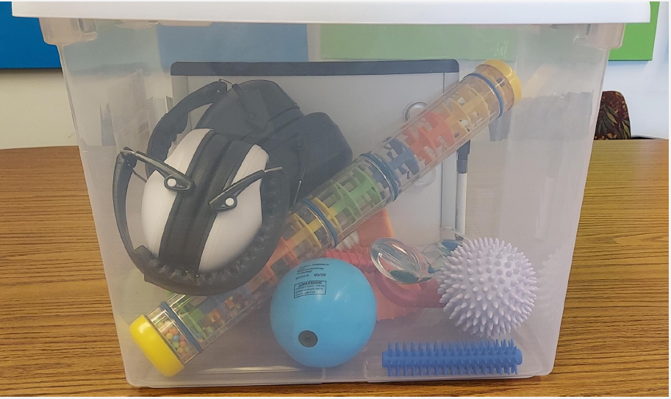
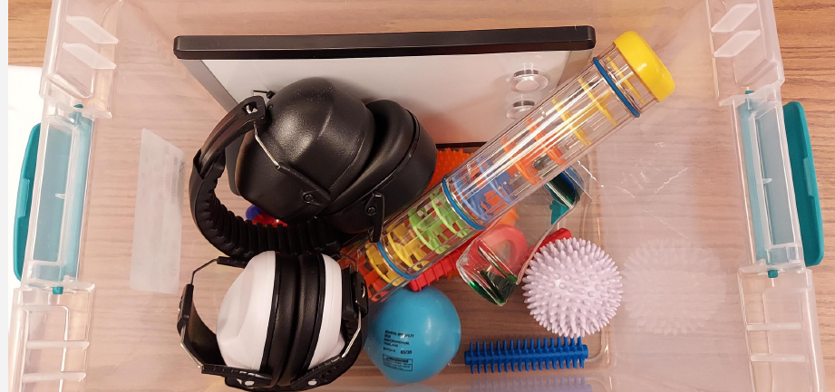
How to Create a Sensory Kit

Slide 2
Why Sensory Kits are Important
Neurodiversity is an invisible disability
Includes Populations:
Autism: 1 in 36 prevalence in MN
ADHD
Dyspraxia
More
Affects all racial, ethnic, and socio-economic groups
Neurodivergent people can experience both sensory sensitivities:
HYPER/too much (avoids input) and
HYPO/not enough (seeks input)
These experiences can lead to chaotic and/or unpredictable input AND difficulty filtering extraneous input.

Slide 3
Why Sensory Kits are Important
Allow individuals to regulate their sensory sensitivities in ways that work for them.
Attendees are able to stay at events and community spaces longer.
Sensory Kits provide:
An inclusive resource
A culture of acceptance
A sense of belonging
Events and organizations with inclusive spaces have greater engagement

Slide 4
What Senses to Target

Slide 5
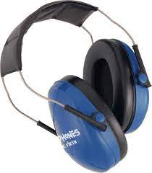
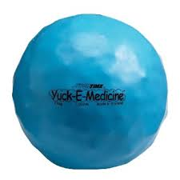
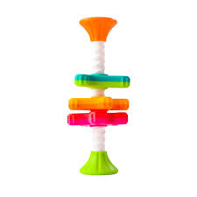
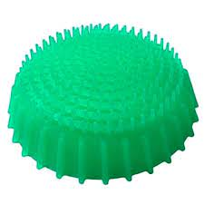
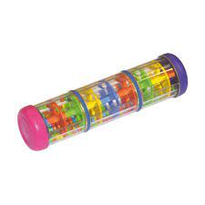
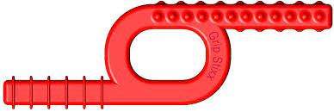
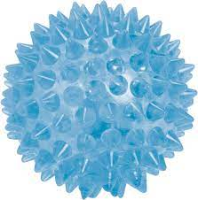
Tools You Can Choose to Include
Headphones (auditory)
Child and Adult Sizes
Mini-Spinny (visual)
Rainstick (visual; auditory)
Spikey Ball (touch)
Yuck-E Ball (touch, proprioceptive)
Figipod (vestibular, proprioceptive, touch)
Grip Stixx Chewy (proprioceptive, touch, taste)
*Include items that are relevant to your site, audience, event, etc. Try to include items that target a variety of senses.

Slide 6
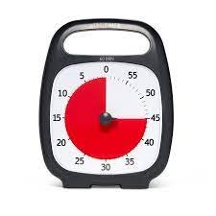
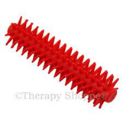
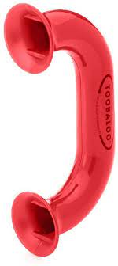
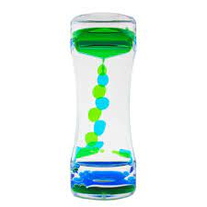
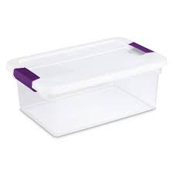
Tools You Can Choose to Include
Sensory Stixx- Hand (proprioceptive, touch)
Toobaloo (auditory)
Bubble Tumbler (visual)
Whiteboard and Marker (interoceptive, visual)
Stress Ball (touch, proprioceptive)
Time Timer (visual)
Disposable Earplugs (auditory)
Giveaway Sunglasses (visual)
Plastic Bin (to store items)
Backpack/Fanny Pack (to store items)
*Include items that are relevant to your site, audience, event, etc. Try to include items that target a variety of senses.
Notes:
Disposable Earplugs
Giveaway Sunglasses

Slide 7
Where to Purchase Sensory Tools
Pre-made and customizable sensory kits prepared by AuSM
Typical Kit Cost $189
Can customize to your budget or tool needs
Benefits of ordering through AuSM
Tools will match your site/individual needs
Funds will directly support individuals connected to AuSM
www.toysmith.com
www.thetoynetwork.com
www.schylling.com
www.getspeks.com
www.playvisions.com
www.timetimer.com
www.funinmotionntoys.com
www.tanglecreations.com
www.discovervibes.com
www.amazon.com

Slide 8
For More Information
Contact Education Department at education@ausm.org for a kit request or guidance
Visit www.ausm.org

